Slide 1
Deep Neural Network

Slide 2

Deep Neural Network
Disclaimer and Acknowledgement
The content for these slides has been obtained from books and various other source on the Internet
I here by acknowledge all the contributors for their material and inputs.
I have provided source information wherever necessary
I have added and modified the content to suit the requirements of the course

Slide 3
Session Agenda
Multi-class Classification
Deep Feedforward Neural Networks
Activation Functions
Computational Graph
Forward Propagation

Slide 4
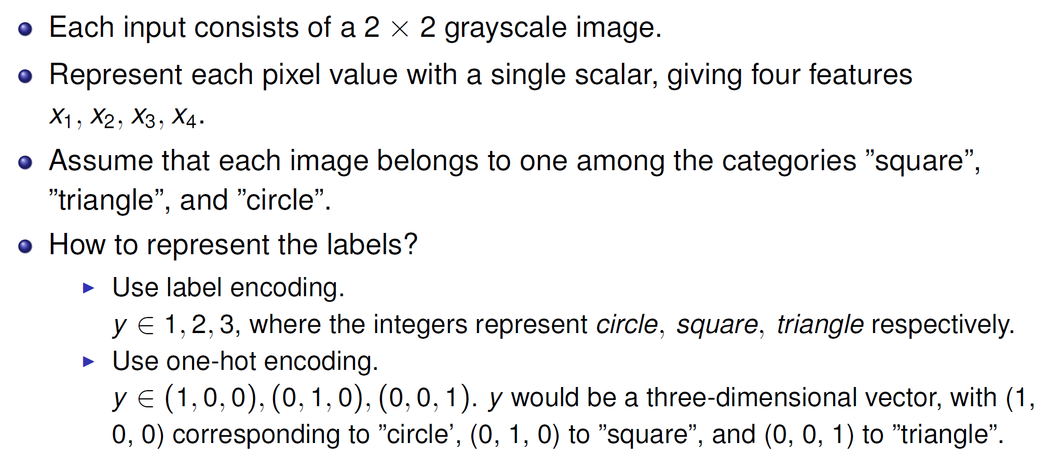
Multi-class Classification Example

Slide 5
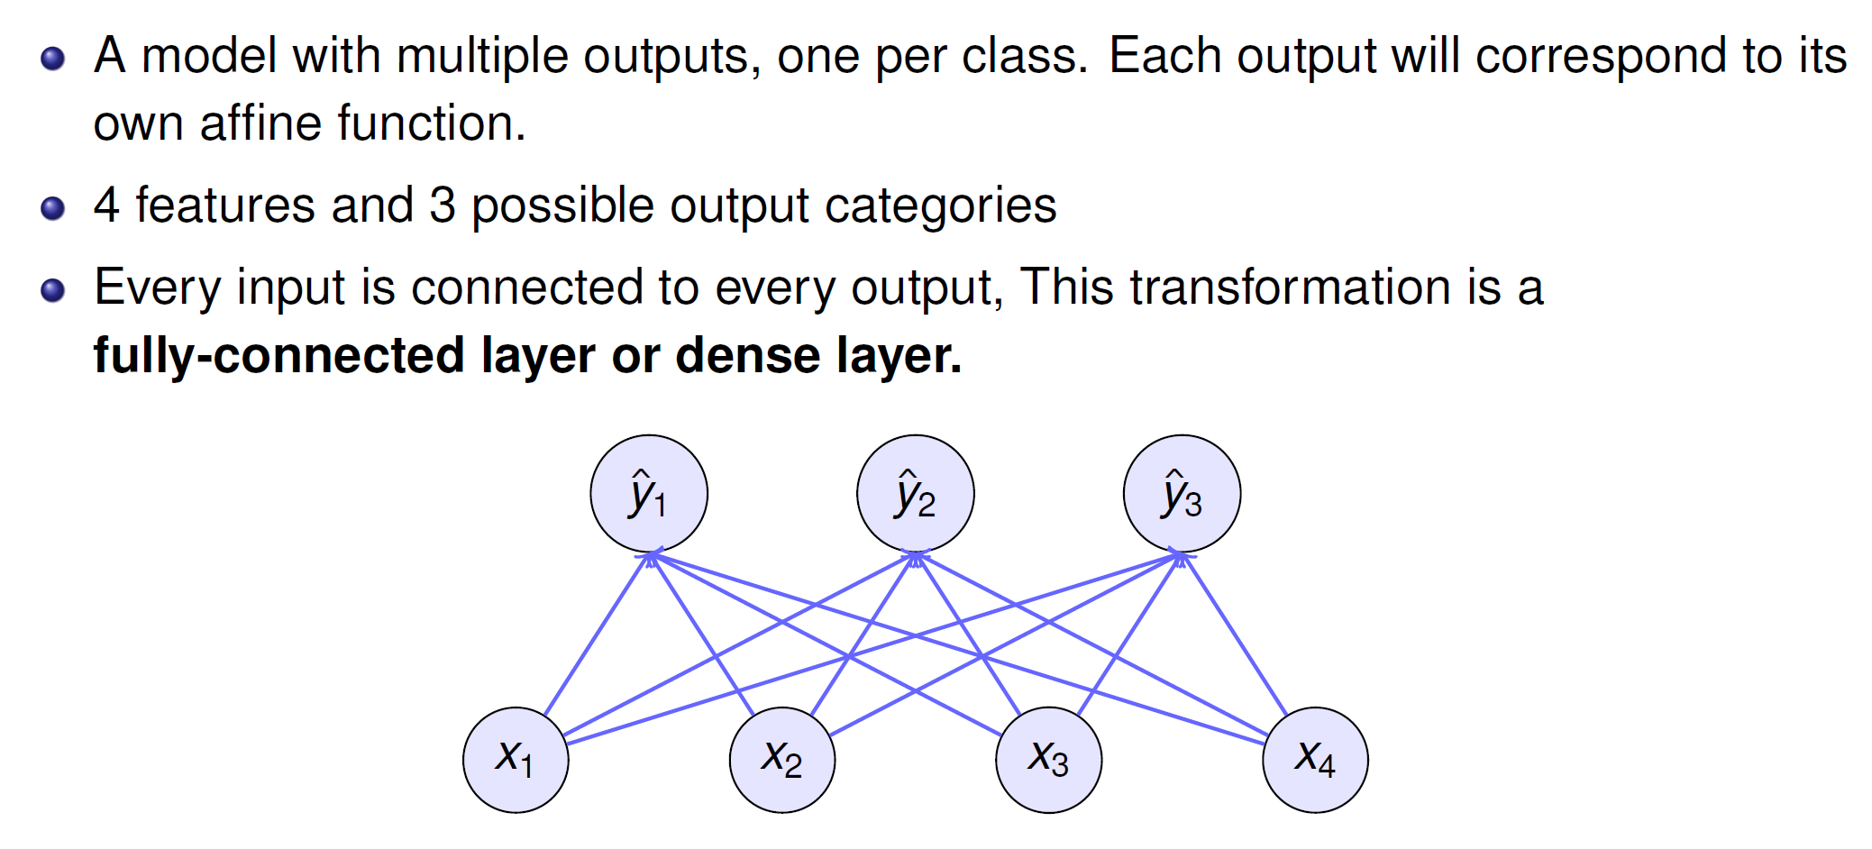
Single-Layer Neural Network

Slide 6
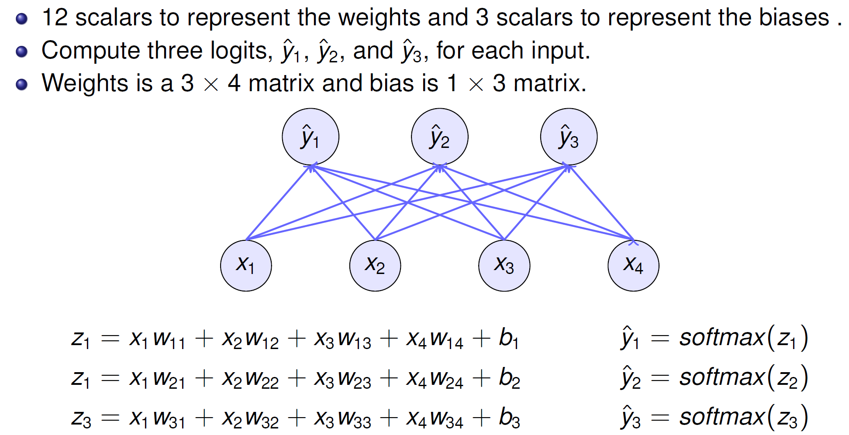
Single-Layer Neural Network

Slide 7
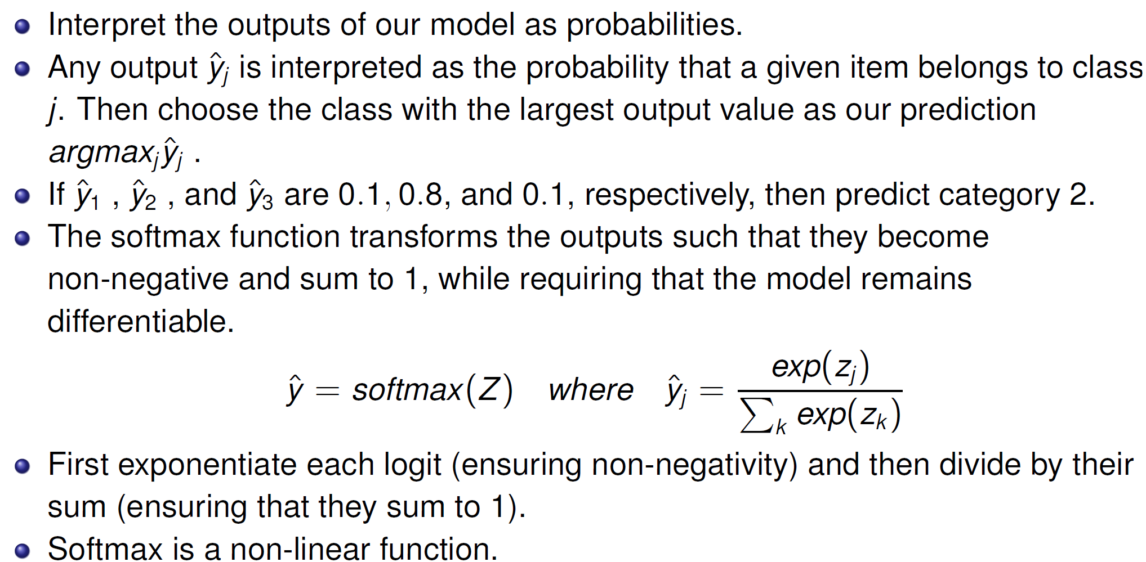
Softmax Operation

Slide 8
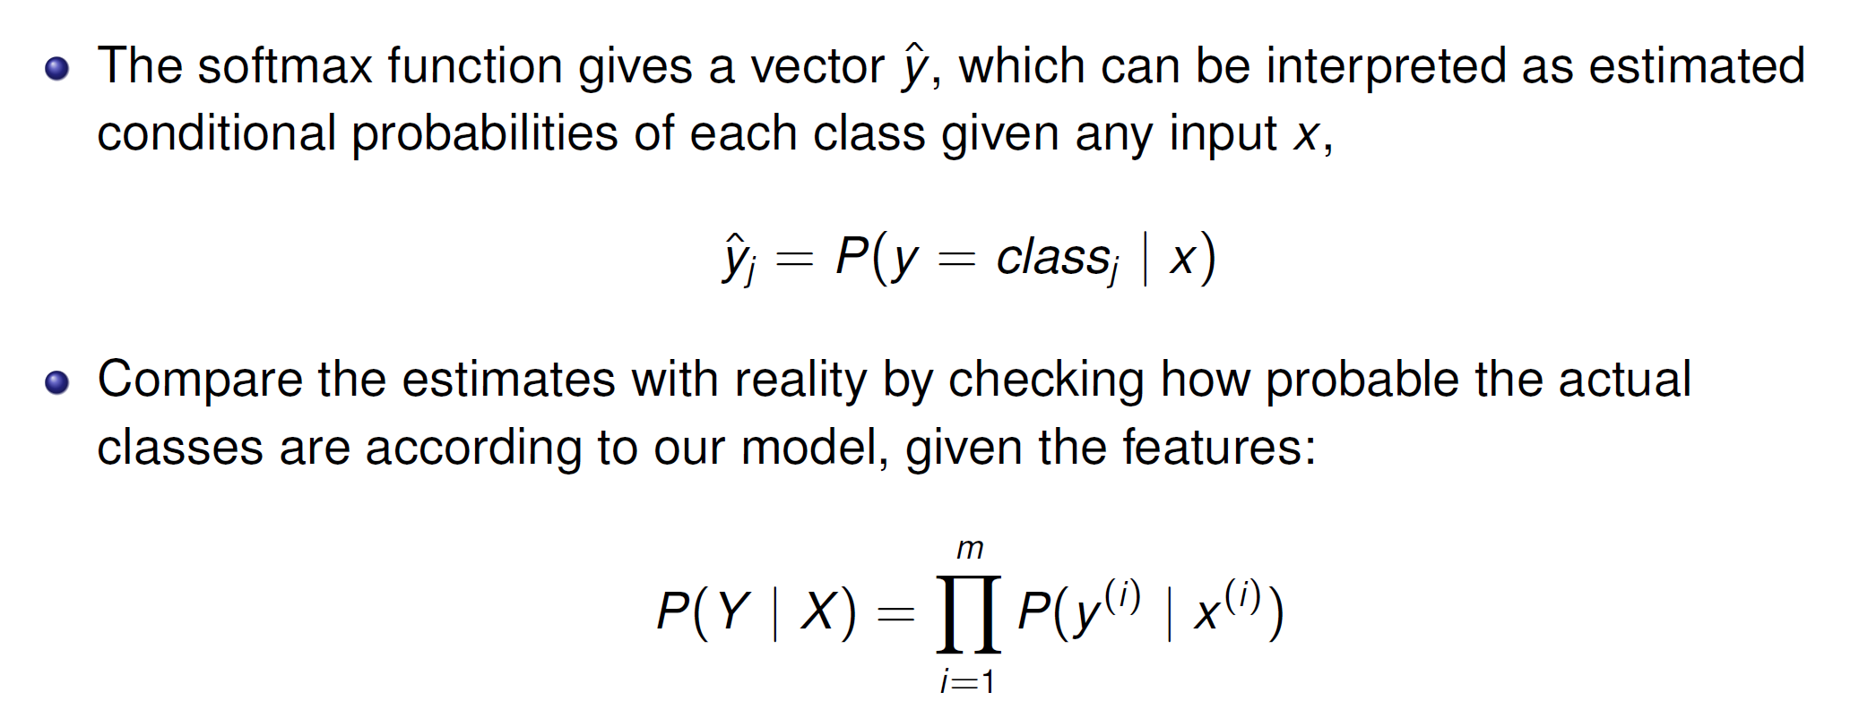
Log-Likelihood Loss / Cross-Entropy Loss

Slide 9
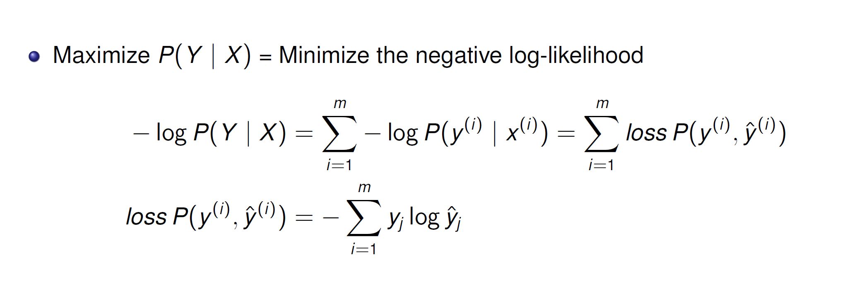
Log-Likelihood Loss / Cross-Entropy Loss

Slide 10
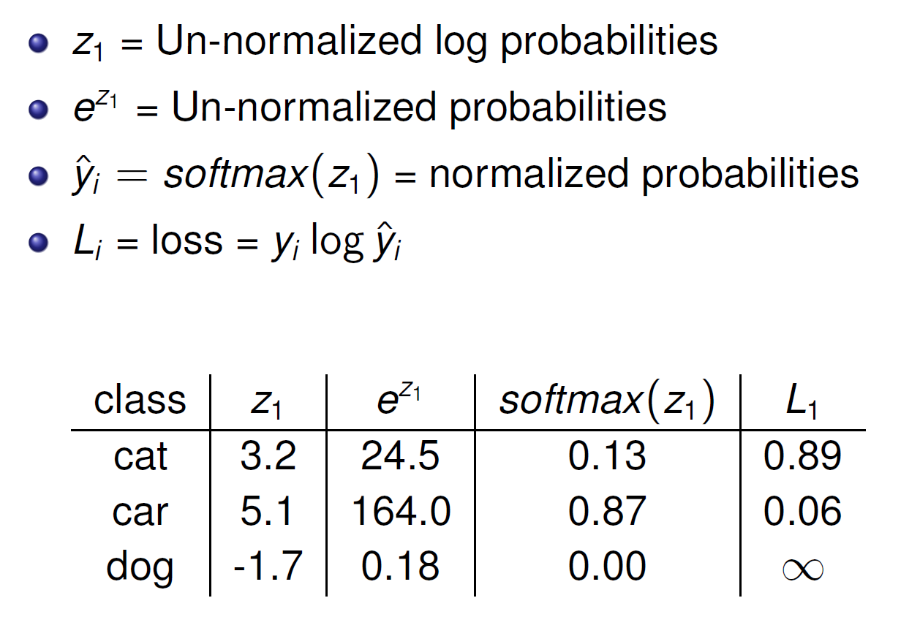
Softmax Example

Slide 11
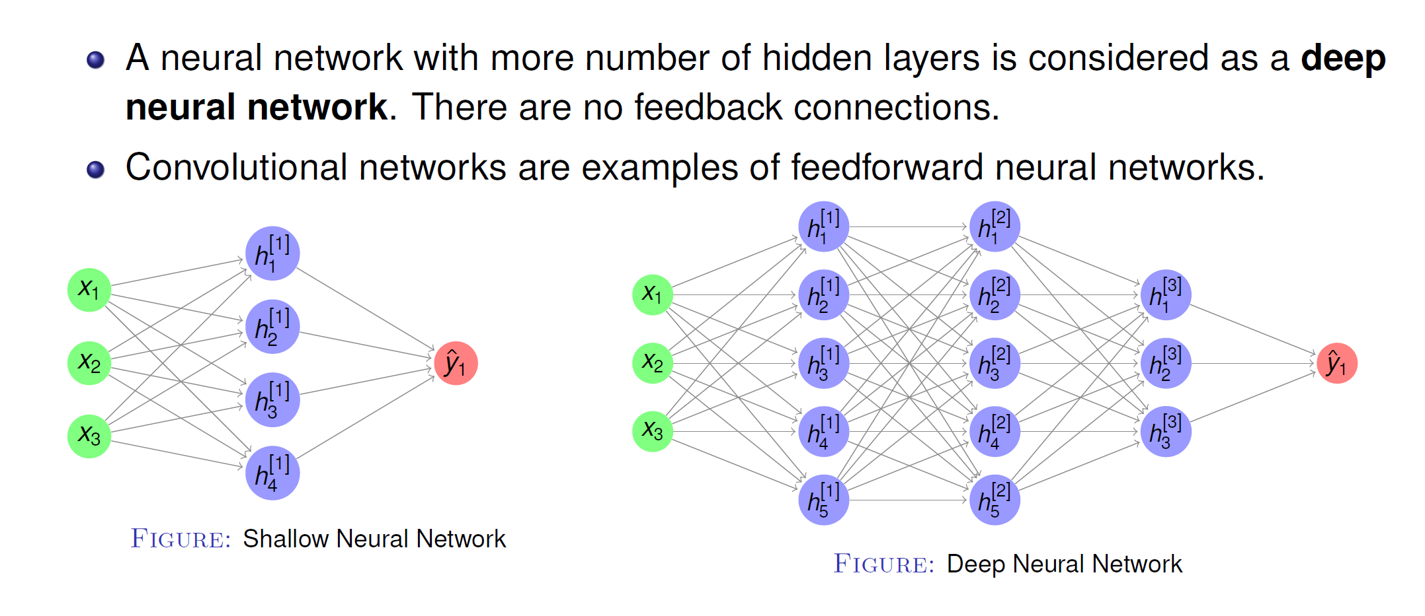
Deep Feedforward Neural Networks

Slide 12
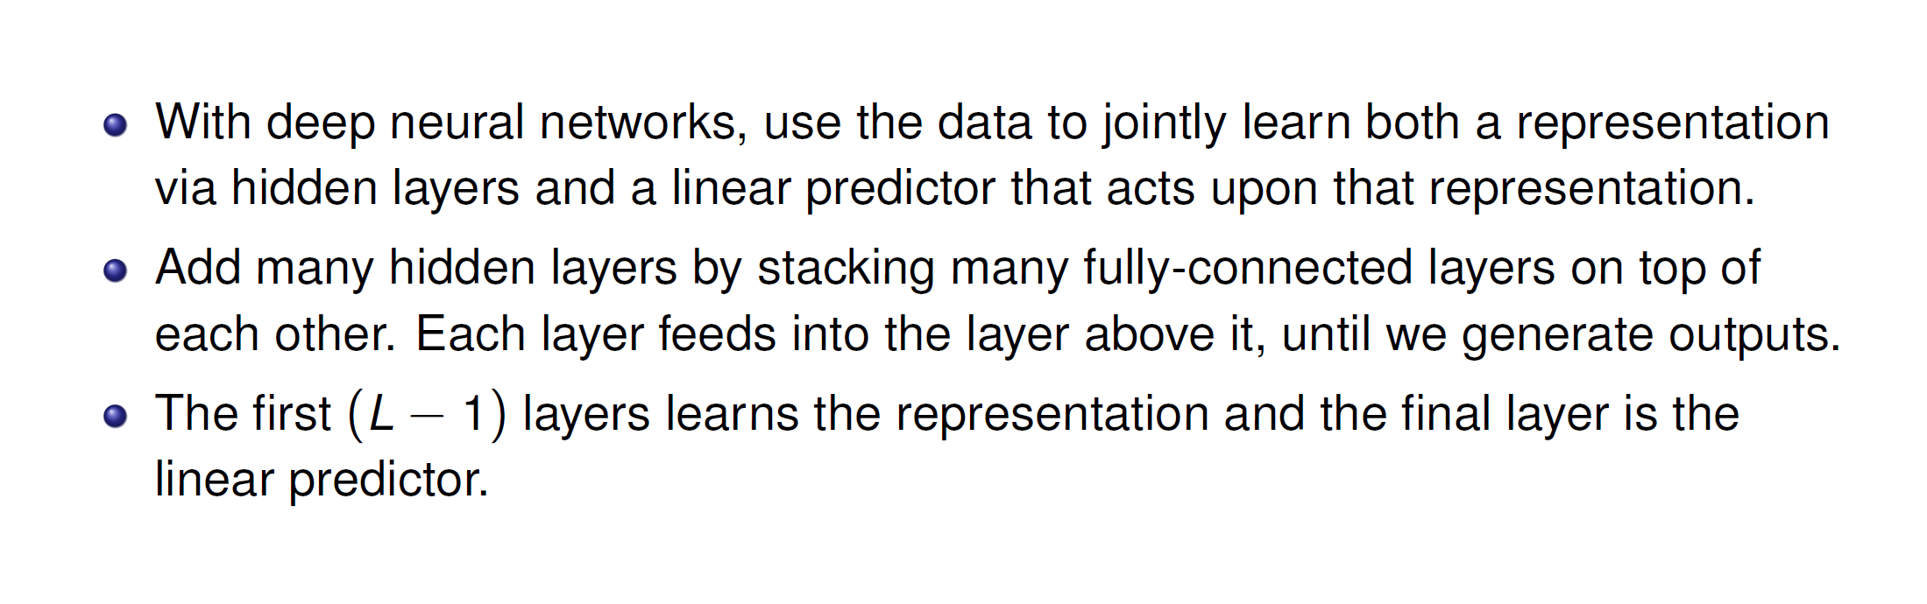
Deep Feedforward Neural Networks

Slide 13
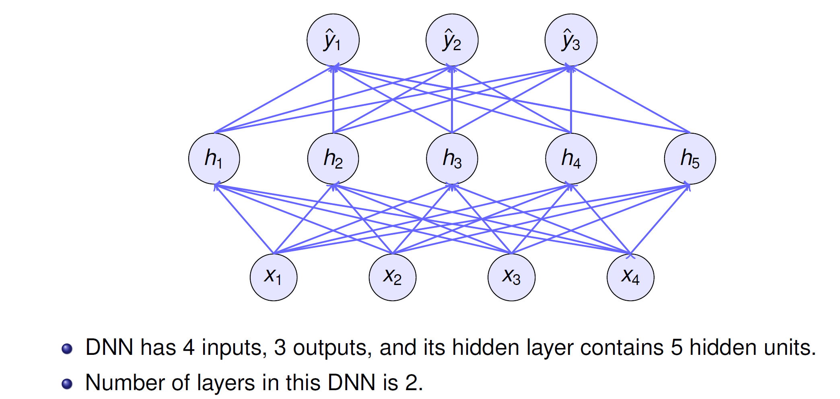
DNN Architecture

Slide 14
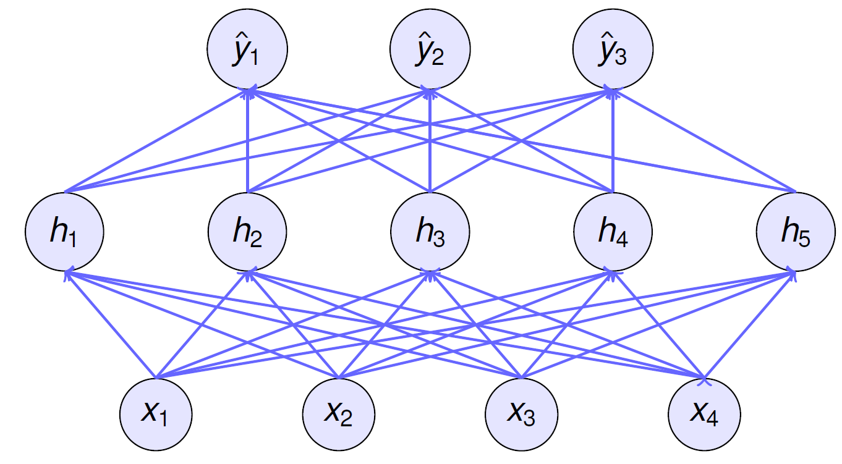
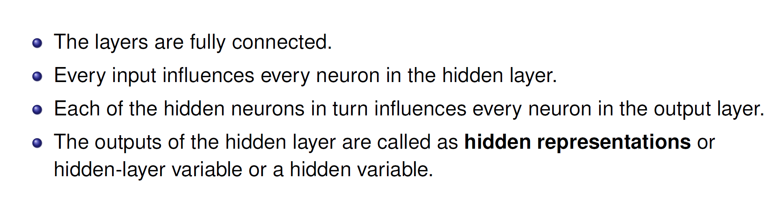
DNN Architecture

Slide 15
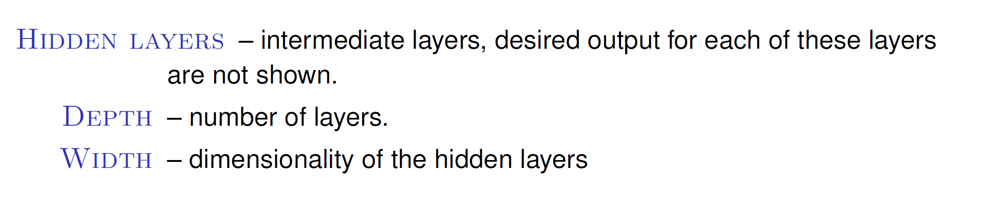
DNN Architecture

Slide 16
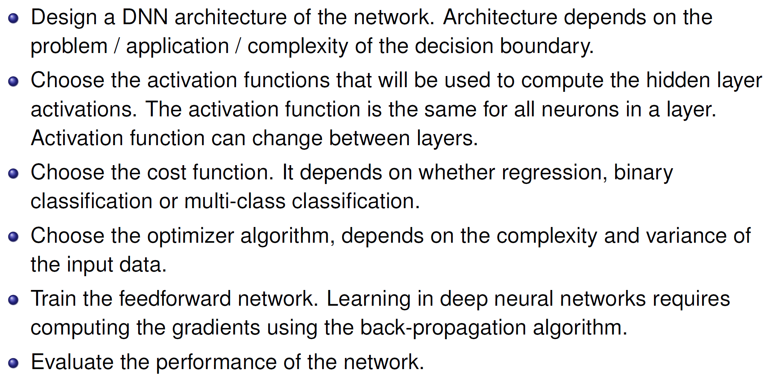
DNN - General Strategy

Slide 17
The Flow of Computations in Neural Networks
The flow of computations in a neural network goes in two ways:
Left-to-right: This is referred to as forward propagation, which results in computing the output of the network
Right-to-left: This is referred to as back propagation, which results in computing the gradients (or derivatives) of the parameters in the network
The intuition behind this 2-way flow of computations can be explained through the concept of “computation graphs”

Slide 18
Computation Graphs
Each node in the graph indicate a variable.
An operation is a simple function of one or more variable.
An operation is defined such that it returns only a single output variable.
If a variable y is computed by applying an operation to a variable x , then we draw a directed edge from x to y .

Slide 19
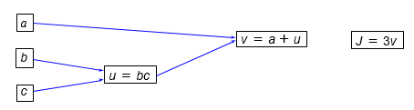
Computation Graphs Example
Forward Pass:
Let J(a, b, c) = 3(a + bc)
u = bc
v = a + u
Then J = 3v

Slide 20
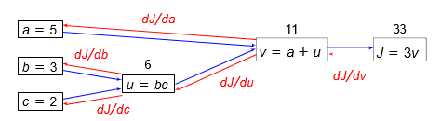
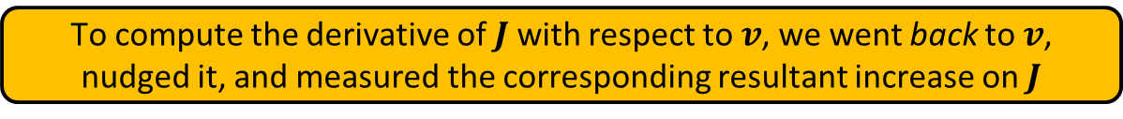
Computation Graphs Example
Backward Pass / Back propagation of gradients:
Let J(a, b, c) = 3(a + bc)
u = bc
v = a + u
Then J = 3v

Slide 21
Computation Graph – Binary Classification
Forward Pass:
z = w ^{T}X + b
a = y^{ˆ} = σ(z)
L(a, y ) = − [y log a + (1 − y ) log(1 − a)]
x₁
w₁
z = w₁x₁ + b
a = σ(z)
L(a, y )
b

Slide 22
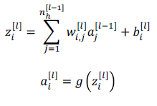
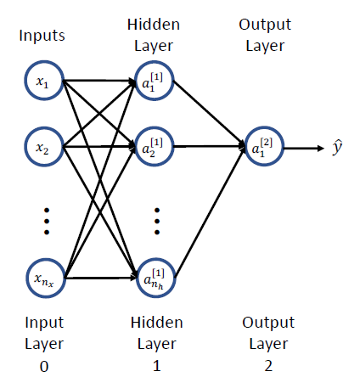
Formalizing Neural Network Construction
Let’s consider a 2-layer Network
Output of one activation unit
Where
𝑔() = activation function
𝑤^{[𝑙]} = weight parameter of input 𝑎^{[𝑙-1]} going to unit 𝑎^{[𝑙]}
𝑛_{𝑥} = number of features (model inputs)
𝑛_{ℎ} = number neurons/units in hidden layer
x_{i} = a_{i}^{[0]}

Slide 23
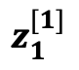
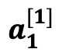
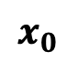
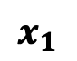
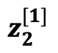
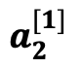
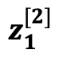
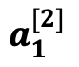
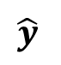
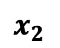
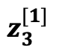
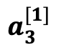
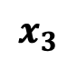
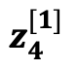
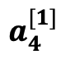
2-layer NN
Interestingly, neural networks learn their own features!
Output layer
Layer 2
Input Layer
(or Layer 0)
Hidden layer with 4 neurons
Layer 1

Slide 24
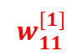
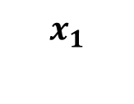
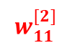
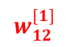
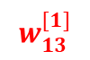
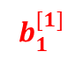
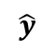
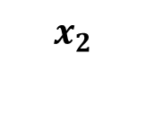
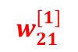
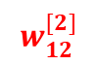
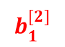
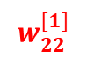
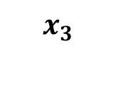
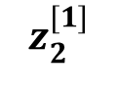
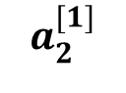
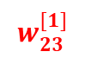

Example (without vectorization)

Slide 25


Vectorizing Input and All Variables
To help develop an efficient learning algorithm, let us vectorize (represent in vectors & matrices) the input and the variables involved
Layer 2
Input Layer
(or Layer 0)
Layer 1

Slide 26





Vectorizing Input and All Variables
Layer 2
Input Layer
(or Layer 0)
Layer 1

Slide 27






Vectorizing Input and All Variables
Layer 2
Input Layer
(or Layer 0)
Layer 1

Slide 28






Vectorizing Input and All Variables
Layer 2
Input Layer
(or Layer 0)
Layer 1

Slide 29


Vectorizing Input and All Variables
Layer 2
Input Layer
(or Layer 0)
Layer 1

Slide 30


Vectorizing Input and All Variables
Layer 2
Input Layer
(or Layer 0)
Layer 1

Slide 31






Vectorizing Input and All Variables
Layer 2
Input Layer
(or Layer 0)
Layer 1
In matrix form

Slide 32





Vectorizing Input and All Variables
Layer 2
Input Layer
(or Layer 0)
Layer 1

Slide 33














Vectorizing Input and All Variables

Slide 34







Vectorizing Input and All Variables

Slide 35








Vectorizing Input and All Variables
Forward propagation equations
Layer 2
Input Layer
(or Layer 0)
Layer 1
For l^{th} layer
But, this assumes only 1 training example!

Slide 36








Vectorizing Input and All Variables

Slide 37
Vectorizing Input and All Variables
Assuming m examples
But, loops in general slow down programs; hence, it is better to further vectorize the implementation in order to avoid any loop, whenever possible

Slide 38

Vectorizing Input and All Variables

Slide 39





Vectorizing Input and All Variables
This vector represents the first example in the training dataset
A^{[0]} shape =(n_{x}, m)

Slide 40




Vectorizing Input and All Variables
No. of hidden units at layer 1 =n_{h} = 4
Z^{[1]} shape =(n_{h},m)

Slide 41



Vectorizing Input and All Variables
A^{[1]} shape =(n_{h},m)

Slide 42




Vectorizing Input and All Variables
Z^{[2]} shape =(1,m)
A^{[2]} shape =(1,m)

Slide 43









Forward propagation equations
No Explicit Loop!
Before Vectorization
After Vectorization

Slide 44

Matrix dimensions

Slide 45

Dimensions for 1 training example:
a^{[0]} shape =(2,)
w^{[3]} shape =(3,4)
b^{[3]} shape =(3,)
z^{[3]} shape =(3,)
ŷ = a^{[3]} shape =(3,)
(𝒏_{𝒉}^{[l]}, 𝒏_{𝒙})
(𝒏_{𝒉}^{[l]}, )
(𝒏_{𝒉}^{[l]}, )
(𝒏_{𝒉}^{[l]}, )
w^{[1]} shape =(5,2)
b^{[1]} shape =(5,)
z^{[1]} shape =(5,)
a^{[1]} shape =(5,)
w^{[2]} shape =(4,5)
b^{[2]} shape =(4,)
z^{[2]} shape =(4,)
a^{[2]} shape =(4,)

Slide 46
Forward Step
Given some [initial] values for the parameters, we can compute the forward pass, layer by layer.
Forward pass is basically 𝐿 matrix multiplications, each followed by an activation function.
Matrix multiplication can be done efficiently with GPUs.
Therefore, forward pass is somewhat fast.
Complexity of forward pass, linear of depth 𝑂(𝐿) .

Slide 47
References
Ref: Chapter 3 and 4 of T1
http://neuralnetworksanddeeplearning.com/chap4.html
https://cs229.stanford.edu/lectures-spring2022/main_notes.pdf
http://neuralnetworksanddeeplearning.com/chap2.html

Slide 48
Practice problems

Slide 49

Example 1 Computational Graph for Back Propagation

Slide 50

Computational Graph for Back Propagation

Slide 51

Computational Graph for Back Propagation

Slide 52

Computational Graph for Back Propagation

Slide 53

Computational Graph for Back Propagation

Slide 54

Computational Graph for Back Propagation

Slide 55

Computational Graph for Back Propagation

Slide 56

Computational Graph for Back Propagation

Slide 57

Computational Graph for Back Propagation

Slide 58

Computational Graph for Back Propagation

Slide 59

Computational Graph for Back Propagation

Slide 60

Computational Graph for Back Propagation

Slide 61

Computational Graph for Back Propagation

Slide 62

Computational Graph for Back Propagation

Slide 63

Computational Graph for Back Propagation

Slide 64

Computational Graph for Back Propagation

Slide 65

Computational Graph for Back Propagation

Slide 66

Example 2

Slide 67


Slide 68



Slide 69
Thank You All !

